Slide 1
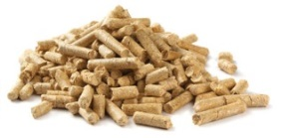
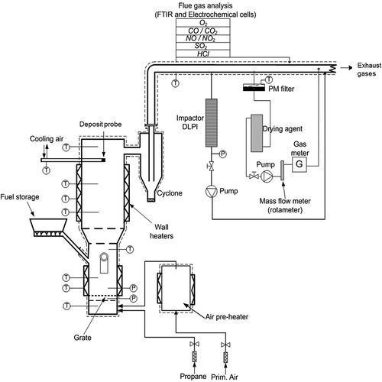
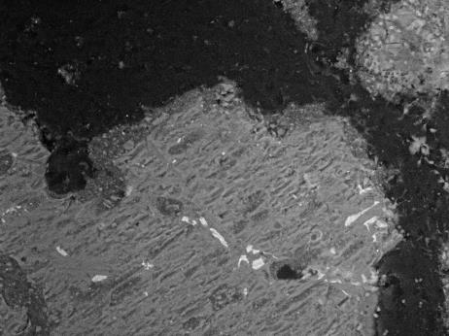
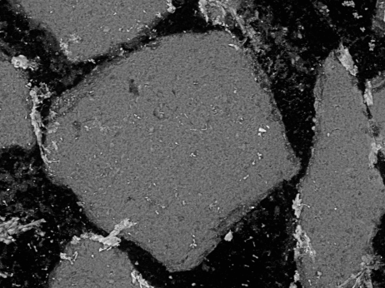
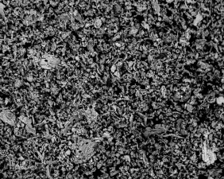
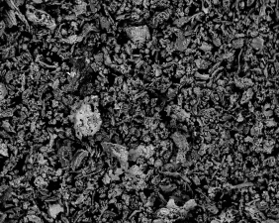
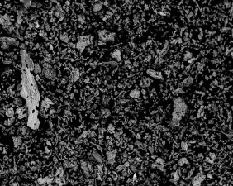
Combustion characteristics of barley straw stored with CaCO₃ during fluidized bed
combustion using quartz and olivine as bed materials
Marjan Bozaghian^{1,*}, Anders Rebbling², Sylvia H. Larsson¹, Shaojun Xiong¹, Nils Skoglund^{2,3}
¹ Swedish University of Agricultural Sciences, Department of Forest Biomaterials and Technology, S-901 83 Umeå, Sweden
² Umeå University, Department of Applied Physics and Electronics, Thermochemical Energy Conversion Laboratory, S-901 87 Umeå, Sweden
³ Luleå University of Technology, Energy Engineering, Division of Energy Science, SE-971 87 Luleå, Sweden
INTRODUCTION
^{*)}corresponding author, . E-mail: marjan.bozaghian@slu.se
In order to achieve a continuous feedstock supply for power plants a large quantity of harvested material must be stored for long-term periods. During storage, especially during right conditions of temperature, moisture and oxygen, solid agricultural fuels are susceptible to microbial activities. Microbial respiration not only leads to loss of organic carbon, but also to an increased temperature in the stored fuel which may lead to self-ignition.
There is on-going work studying the effect of adding Ca as CaO or CaCO₃ during storage of straw with the aim of creating an unfavorable alkaline microenvironment that prevents microbial growth during storage. The effect of this amendment during storage is still being explored, but the effect in the combustion step of the process in terms of determining the potential of Ca-additives to positively affect overall ash chemistry have yet to be certainly quantified.
Utilization of agricultural crops for energy purposes in heat and power plants has proven to be challenging in numerous ways. Compared to woody fuels, agricultural fuels can cause severe ash-related operational problems in combined heat and power plants through by fouling, slagging and/or bed agglomeration due to their high concentrations of inorganic constituents.
The objective of the present study is therefore to determine the fouling and bed agglomeration characteristics during fluidized-bed combustion of barley straw stored with different dosages of Ca to biomass with the main ash-forming elements shown in Figure 1, using two types of bed materials, quartz and olivine.
Figure 1. Fuel fingerprint for used fuels.
METHODOLOGY
Pelletized barley straw stored with Ca-additive
Combustion in bubbling fluidized bed in bench-scale (5 kW)
Samples collected both at the end of combustion and after agglomeration test
Analyses performed
Barley straw
Bed Ash
Bed Grains
Cyclone Ash
Particulate Matter (PM)
Deposits Build-up on Deposition Probe
Gas
Measurements
Barley straw
Low dosage of Ca-additive
Elemental analysis – Scanning electron microscopy (SEM) with Energy Dispersive X-ray Spectroscopy (EDS)
Elemental analysis was carried out using a Zeiss EVO-LS15 equipped with a X-Mmax^{N} 80 mm² EDS detector
Fourier-transformed infrared spectroscopy (FTIR)
Gas measurements performed using a Gasmet DX-4000 FTIR
Barley straw
High dosage of Ca-additive
Grain size of quartz and olivine bed materials used were 200-250 μm
PRELIMINARY RESULTS
CONCLUSIONS
Gas measurements
Ca addition decreased the amount of alkali interaction between bed ash and bed material
Ca decreased the amount of molten bed ash particles discovered using SEM analysis
Release of gaseous K compounds due to tertiary ash transformation reactions may cause issues with deposition
Addition of Ca to barley straw causes significantly elevated CO concentrations in the flue gases regardless of bed material
Table 1 show indications that CO levels increases with added Ca. As the content of Ca is increasing, K-containing species are driven out and evaporates to the gas phase. Most likely, CO-levels are affected by the increase of gaseous K compounds in the flue gases.
Table 1. Gas measurements data based on average values from 8 hours combustion at 700 °C.
 | Barley Quartz |  | Barley Olivine |  | Barley low Quartz |  | Barley low Olivine |  | Barley high Quartz |  | Barley high Olivine
 | Average | StdDev | Average | StdDev | Average | StdDev | Average | StdDev | Average | StdDev | Average | StdDev
Temp | 695,7 | 4,4 | 691,9 | 9,7 | 690,5 | 6,6 | 687 | 11,7 | 701,9 | 3,3 | 716,6 | 8,8
CO [ppm] | 69,7 | 56,1 | 12 | 39,5 | 6214,8 | 3709,1 | 1851,8 | 1767,5 | 5393,9 | 2377,9 | 6345,5 | 3504,1
O2 [% dry] | 12,6 | 1,1 | 11,6 | 2,1 | 10,4 | 4,2 | 14,7 | 2,5 | 12,8 | 1,7 | 11,3 | 2,4
SEM-images of typical cyclone ash particles formed during combustion
SEM-images of typical cross section of olivine and quartz bed particles
Barley + olivine
Barley + quartz
a) Olivine bed grains after combustion of 100% Barley
b) Quartz bed grains after combustion of 100% Barley
Research financed by
Barley low+ olivine
Barley low+ quartz
Figure 3. Typical cross section of olivine and quartz bed particles taken after 8 h before agglomeration test.
It is evident that olivine bed grains are more resistance to formation of particle layers than quartz bed grains in fluidized-bed combustion of pure barley straw.
No distinguishable layers could be observed in the case of olivine, whereas for quartz grains, molten ash particles adhered to bed particle grains could be observed (Figure 3).
Barley high + olivine
Barley high + quartz
Figure 2. Elemental composition of cyclone ash particles.
Area analysis of the cyclone ash particles, analysed with SEM-EDS analysis, show that in all fuels the cyclone ash was dominated by K, Ca and Si (Figure 2). It is also evident that a large proportion of the added Ca is trapped in cyclone ash which also appears to have an alkali reducing effect through dilution.

