Slide 1
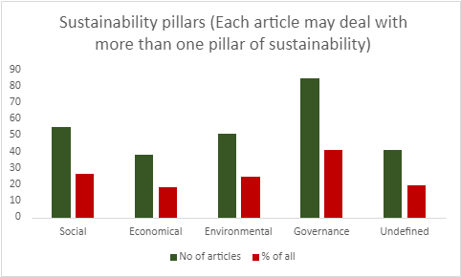
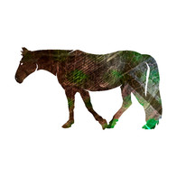
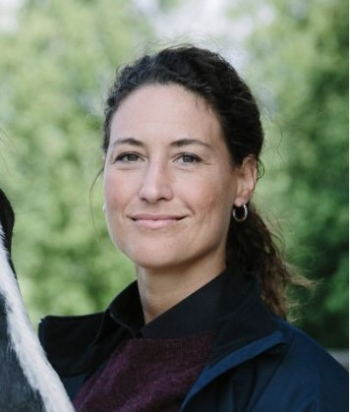
Sustainability in Equine Science
www.slu.se
Linda-Maria Dimitrova Mårtensson & Hanna Sassner, Swedish University of Agricultural Sciences
CONCLUSION
OBJECTIVE
To characterise the state-of-the-art in scientific achievements in terms of sustainability and sustainability assessment within the equine sector, and to map missing pieces and improvement areas, we posed the research question:
Which themes and frameworks
are used in scientific publications to assess sustainability in the equine sector?
Sustainable development is sparsely addressed in equine science and holistic sustainability assessments
are rarely attempted. Quantitative sustainability indicators are lacking.
BACKGROUND
Sustainability assessments have proven to be powerful decision support tools for sustainable development [1]. Despite
the more than 16 million horses globally [2], such holistic assessments are still
rare within the horse industry.
The sustainability wedding cake illustrates the pillars underpinning sustainability: environmental, social, economic, and governance aspects [3].
RESULTS
The search yielded 217 records in Web of Science and 148 records in Scopus. After screening, retrieval and eligibility control [4], 207 abstracts from equine science articles and equine conference contributions were included in the review.
Most records only indirectly addressed sustainability with very few attempts of assessing sustainability, including identifying indicators or quantifiable parameters. All pillars of sustainability could be identified in the records and 22% of abstracts covered more than one pillar and 9% three or more.
The most common theme was sustainable governance of parasite control (28%). Animal Welfare was adressed in 13% of the abstracts whereas Social Licence to Operate (SLO), One Health and One Welfare was mentioned in only in 1%, 2% and 1% respectively.
METHODOLOGY: The systematic literature review followed recommended principles [4] and the PRISMA statement flow diagram [5]. A thematic analysis [6] was conducted for the abstracts included.
REFERENCES: 1. Waas et al., 2014; 2. FAO, 2014; 3. FAO, 2023; 4. Koutsos et al., 2019; 5. Page et al., 2021; 6. Braun & Clarke, 2006
The thematic analysis revealed the highly and rarely occurring themes in equine science records yielded by the search.
Representation of the different pillars of sustainability in the search yield.
Linda-Maria
Dimitrova Mårtensson
Hanna
Sassner
Department of Biosystems & Technology
Associate Professor, PhD
linda.maria.martensson@slu.se
Researcher, PhD
hanna.sassner@slu.se
SLU Alnarp, Sweden
https://www.slu.se/

